Slide 1
MPAI Progress
July 2016

Slide 2
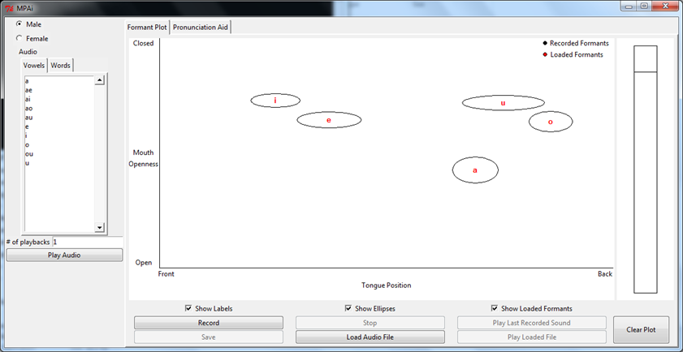
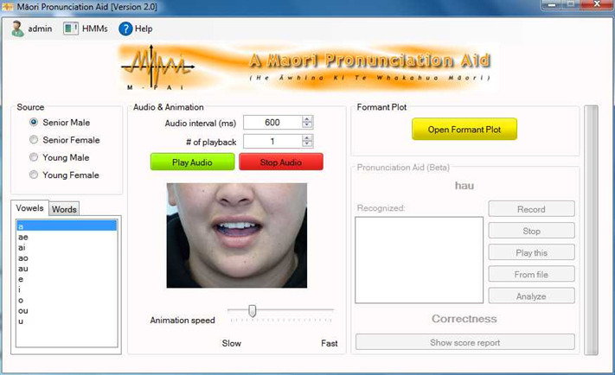
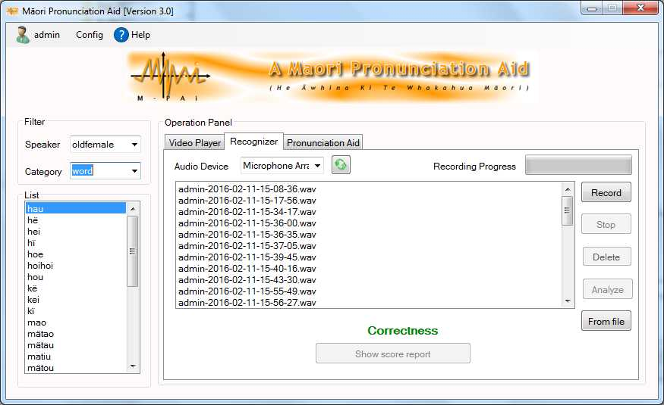
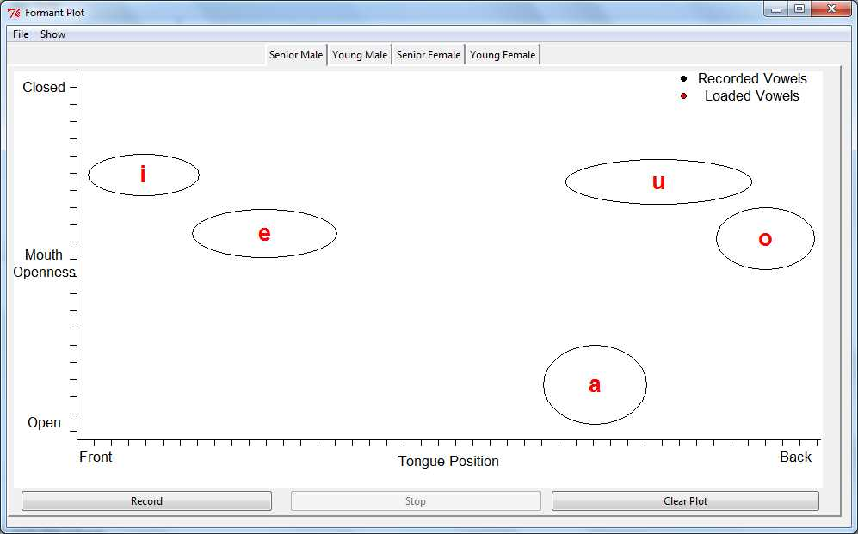
Past Progress of Aid
At Feb 2015
Formant plot
Command line SR
At Oct 2015
Formant plot
Pronunication feedback
based on SR
Summer 2015/2016
Trial of Oct 2015 MPAi by 11 participants
Revisions of Pronunication SR module
Improvement of SR module.
Revision of Formant display

Slide 3
Between Feb 2016 and July 2016
Developing framework for a mobile version of the aid.
Eric Zhai worked on this project
Justine Hui to work on a Māori Speech Synthesizer
Need to develop lexicon
Need to select speaker from MAONZE corpus
Peter presented MPAi project at 2 international conferences.
2016 Keegan P, Watson C, Hoda R, King J, Maclagan M, Harlow R, Developing a Maori Language Pronunciation Tool Based on a Maori Speaker Database. The Asia Conference on Language Learning 2016, Kobe, Japan, 29 Apr 2016 - 01 May 2016. 29 Apr 2016.
2016 Keegan P, Watson C, Hoda R, King J, Maclagan M, Harlow R, Building a Māori Language Pronunciation Tool Based on a Māori Speaker Database New Ways of Analyzing Variation Asia-Pacific 4, Chiayi, Taiwan, 22 Apr 2016 - 24 Apr 2016. 22 Apr 2016

Slide 4
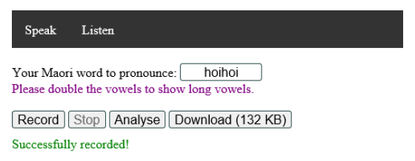
MAORI PRONUNCIATION AID USING THE CLOUD
Eric Zhai did a 1 semester research project developing a web-based version of the MPAI pronunciation Module
Used the Feb 2016 SR algorithm
Can work on Firefox and Microsoft edge.
Issues with audio recording on web-based platform
Need to purchase server
Still a work in progress
Made some interesting Software Engineering
diagrams of the new system

Slide 5
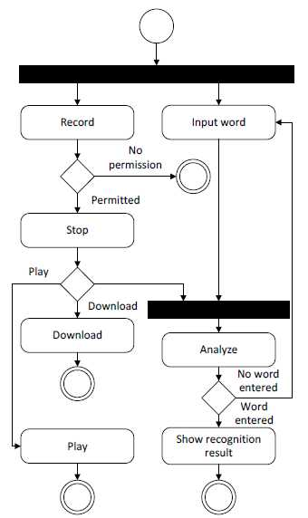
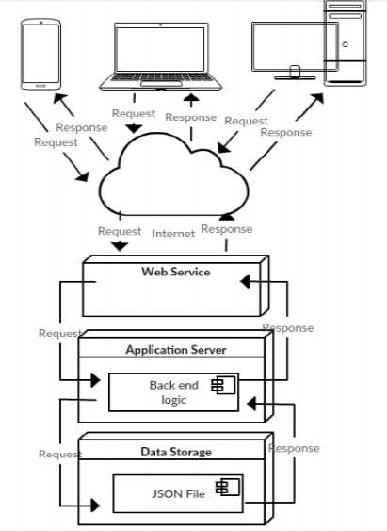
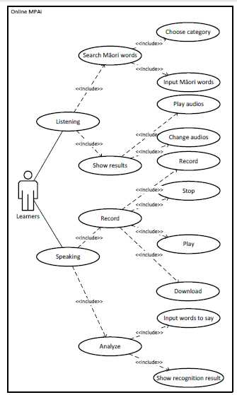
Eric’s Diagrams

Slide 6

Justine’s Work
Working on creating a synthetic voice using K005, based on K005-1, and K005-2 so far. Lots of things aren’t working, so voice sounds choppy. So is proof of concept.
Also takes a long time to process each utterance. Each portion takes a day to process.
Have to remove the recordings of the interviewer
Have to do forced alignment on remaining data
A Kia ora ra: o Rei
English Voice, Māori words
K005 Māori recordings , Māori Words

Slide 7
Other things going along at snails pace
Laura Thompson is selecting a new set of works to train the SR with a new vocabulary.
Laura is also doing a literature review of existing PC and web-based Pronunciation Aids
Writing a paper
This is a niche area in Human Computer Interaction
Journal of Culture, Communication and Knowledge, Indigenous Knowledge Technology Conference, international Journal of Human-Computer Interaction, ACM Transaction on Computer-Human Interfaces.
A woman called Nic Bidwell is a leader in this field.

Slide 8
Road blocks for final phase of Project
No active RAs on core MPAi development
The second survey has not started
Catherine’s workload

